Slide 1
Chapter 1
The System Development Life Cycle

Slide 2
What is System?
a system refers to a collection of interrelated components that work together to achieve a common objective.
A system is “an orderly grouping of interdependent components linked together according to a plan to achieve a specific goal.”
It can be a physical or conceptual entity composed of people, processes, software, hardware, and data.
SAD focuses on understanding, designing, and implementing systems to meet specific business needs.

Slide 3
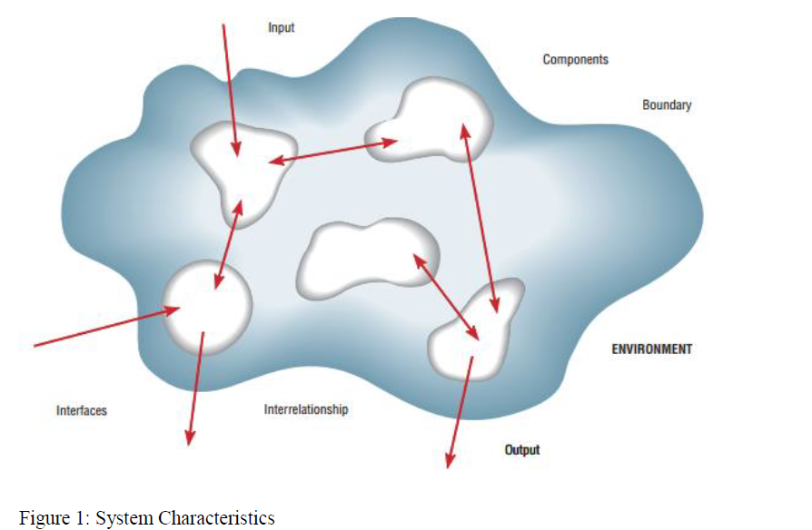
The main system characteristics include:

Slide 4
The main system characteristics include:
Interrelated components
Boundary
Purpose
Environment
Interfaces
Constraints
Input
Output

Slide 5
What is System Analysis and Design(SAD)?
Systems Analysis and Design (SAD) is a structured process used to study, understand, design, and implement information systems that effectively support business needs. It focuses on analyzing existing systems, identifying problems or opportunities, and designing new or improved systems.
The main goal of SAD is to improve organizational systems, typically through applying software that can help employees accomplish key business tasks more easily and efficiently.

Slide 6
Key components of SAD
1. System Analysis – Understanding and breaking down the existing system:
Collecting requirements
Studying workflows and processes
Identifying problems or inefficiencies
Specifying what the new system should achieve

Slide 7
Cont...
2. System Design – Planning how the new system will work:
Designing inputs, processes, and outputs
Creating data flow diagrams, ER diagrams, UML models, etc.
Planning databases, interfaces, and architecture
Specifying hardware/software requirements

Slide 8
Example
Analysis: In a university registration system, identify issues like delays, errors in student records, or lack of online access.
Design: Propose a web-based registration platform. automated verification, and database integration.

Slide 9
System Development Life Cycle(SDLC)
Definition
is a framework that outlines the phases and activities involved in developing and maintaining a software system.
It provides a structured approach to managing the entire process, from the initial concept and requirements gathering to the system's deployment and maintenance.
The SDLC helps ensure that the software development process is systematic, efficient, and produces high-quality results.

Slide 10
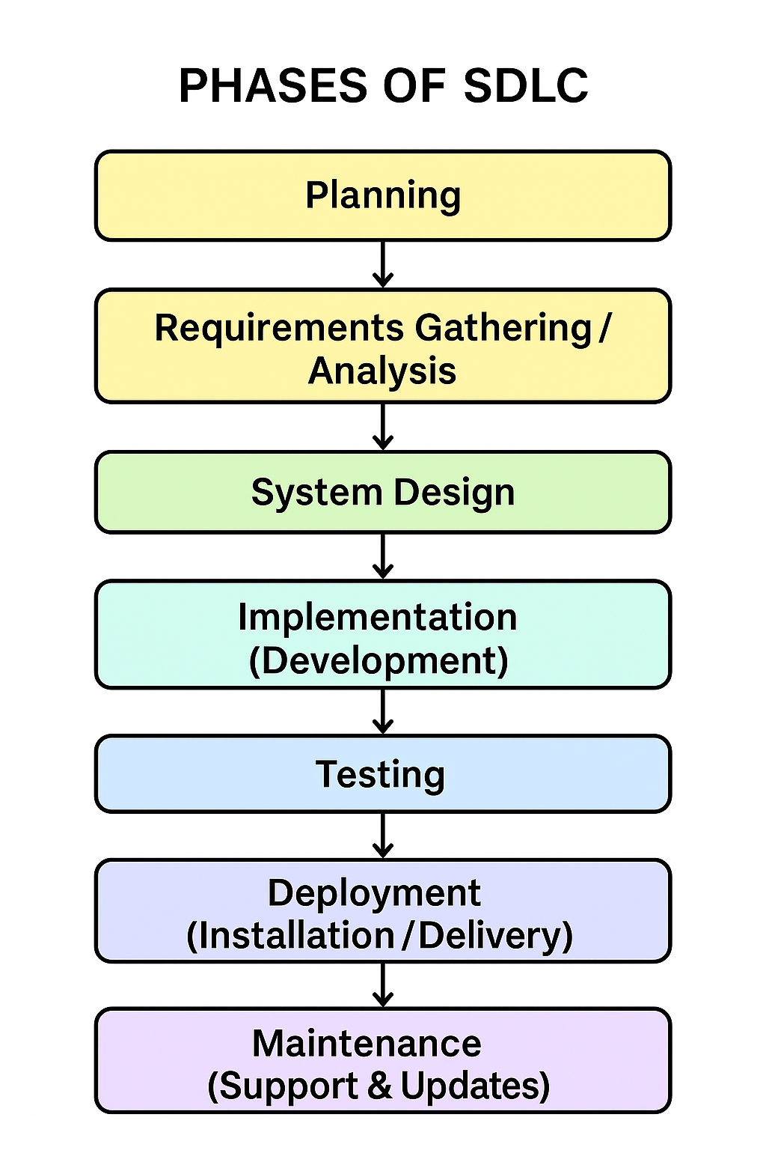

Slide 11
1. Planning Phase
The initial phase where the project idea is studied.
Main goal is to determine the feasibility, resources needed, and project scope.
Activities:
Identify project objectives.
Conduct feasibility studies (technical, economic, operational).
Estimate costs, timelines, and resources.
Prepare a project plan.

Slide 12
Assessing Project Feasibility
Most feasibility factors are the following six categories:
Economic
Operational
Technical
Schedule
Legal and contractual
Political

Slide 13
Example
A university decides to develop a web-based student registration system.
In planning, they check:
Is it technically possible to build it?
What budget is required?
How long will it take?

Slide 14
2. Requirements Gathering
(Analysis Phase)
Collecting and analyzing the requirements of the new system from users and stakeholders.
Activities:
Interview users, distribute questionnaires, and observe processes.
Document functional requirements (what the system should do).
Document non-functional requirements (performance, security, reliability).

Slide 15
Example
For the registration system:
Students need to register online for courses.
Admins need to add/edit courses.
The system must be available 24/7 and secure with login authentication.

Slide 16
1. Primary Data Collection
Primary data is original data collected directly from the source for the specific purpose of the system being developed.
It is first-hand, up-to-date, and specific to the project.

Slide 17
Methods:
Interviews: Asking users, managers, or stakeholders about their requirements.
Interviewing teachers about student registration procedures.
Questionnaires/Surveys: Collecting structured responses from many users.
Surveying students to know which features they want in a portal.
Observation: Watching current processes in action.
Observing library staff to understand book issue and return workflows.

Slide 18
2. Secondary Data Collection
Secondary data is existing information that was collected previously for another purpose but can be used to inform system design.
Sources:
Documents and Reports: Existing forms, manuals, and operational reports.
Databases: Existing data stored in old systems.
Research Studies / Publications: Reports or studies relevant to the domain.

Slide 19
3. Design Phase
Translating requirements into a blueprint for building the system.
Includes both logical design (processes, data flow) and physical design (database, UI, system architecture).
Activities:
Draw UML diagrams (use case, class, sequence).
Create ERDs for database design.
Design system architecture (hardware, software, network).
Prepare user interface mockups.

Slide 20
Example:
ERD with Student, Course, and Registration tables.
Use Case Diagram: Student → Register for course.
Interface design: Login page, registration form.

Slide 21
4. Implementation (Development) Phase
Actual coding and development of the system based on the design.
Activities:
Developers write code using programming languages (e.g., Java, Python, PHP).
Database is created.
Integrate different modules.

Slide 22
Example:
Developers create the login system using PHP.
Database in MySQL is set up with tables for students and courses.
Registration module is coded to check prerequisites.

Slide 23
5. Testing Phase
The system is tested to ensure it meets requirements and works correctly.
Activities:
Unit testing (individual modules).
Integration testing (modules together).
System testing (whole system).
User Acceptance Testing (UAT).

Slide 24
6. Deployment Phase
Delivering the system to users for actual operation.
Activities:
Install system on production servers.
Train users and provide manuals.
Go-live (system becomes available for use).

Slide 25
Example:
The registration system is deployed on the university server.
Students start using it to register for next semester.
Training sessions are given to staff.

Slide 26
7. Maintenance Phase
Ongoing support after deployment to fix problems, improve performance, and adapt to changes.
Activities:
Bug fixing.
Adding new features.
Performance optimization.
Security updates.

Slide 27
Example:
Fix a bug where some courses are not displaying.
Add a feature for online payment of fees.
Upgrade system security with stronger password rules.

Slide 28
8. Documentation
(Cross-cutting Phase)
Detailed recording of the system at every stage of SDLC for reference, training, and future improvements.
Types of Documentation:
Planning docs: Feasibility reports, project plans.
Requirements docs: Requirements specifications.
Design docs: UML diagrams, ERDs, architecture designs.
Implementation docs: Source code comments, technical manuals.
User docs: User manuals, help guides.
Maintenance docs: Logs of changes, updates, bug fixes.

Slide 29
Summary
Planning: Decide to build the system.
Requirements: Collect needs from students and admin.
Design: Create diagrams, DB schema, UI mockups.
Implementation: Developers code modules.
Testing: Verify system works as expected.
Deployment: Install system for real use.
Maintenance: Fix bugs, add features.
Documentation: Manuals, reports, diagrams.

Slide 30
Stakeholders
Stakeholders are individuals or groups who have an interest in the success or outcome of a system or project.
Types of Stakeholders:
Internal stakeholders → Students, instructors, administrators, employees, IT staff.
External stakeholders → Customers, suppliers, government agencies.
Primary stakeholders → Direct users of the system (e.g., students using a registration system).
Secondary stakeholders → Indirectly affected (e.g., finance office that monitors payments).

Slide 31
Project Team Composition
The structure of the project team responsible for planning, designing, developing, testing, and maintaining the system.
For a student registration system:
1 Project Manager, 2 System Analysts, 2 Developers, 1 Database Administrator, 1 Tester, 1 Trainer.

Slide 32
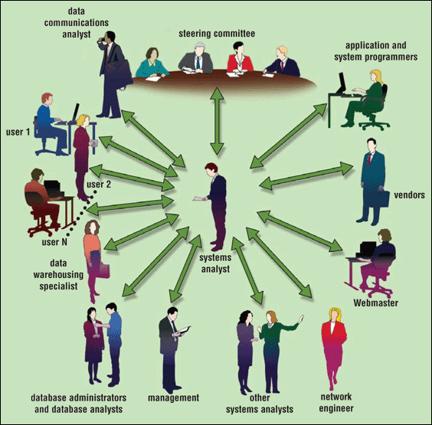
Who participates in the project

Slide 33
Roles in Project Team:
Project Manager → Oversees planning, scheduling, and coordination.
System Analyst → Bridges communication between stakeholders and developers; gathers requirements.
Software Designer → Designs architecture, databases, and user interfaces.
Developers/Programmers → Write and implement the system code.
Database Administrator (DBA) → Manages database design and security.
Tester/Quality Assurance (QA) → Ensures system works correctly and meets requirements.
End-user Representative → Provides feedback on usability and system functions.
Support & Maintenance Staff → Handle issues after deployment.

Slide 34
Thanks!!!

